Slide 2
Machine
Learning
Oliver Zhang and Joshua Zhu

Slide 4
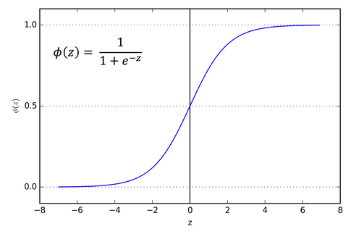

Slide 6
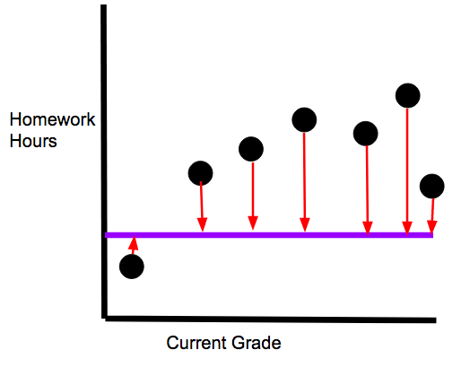
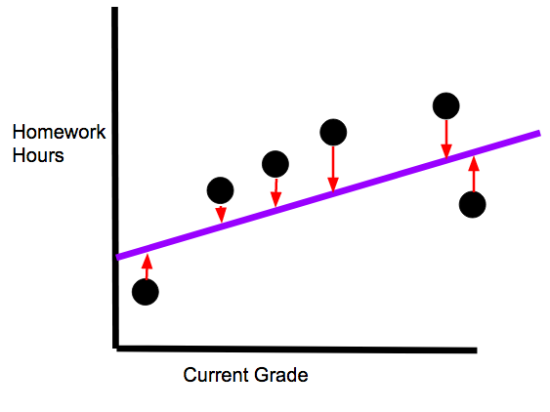

Slide 8
Gif for Gradient Descent
Notes:
Source: https://alykhantejani.github.io/images/gradient_descent_line_graph.gif

Slide 12
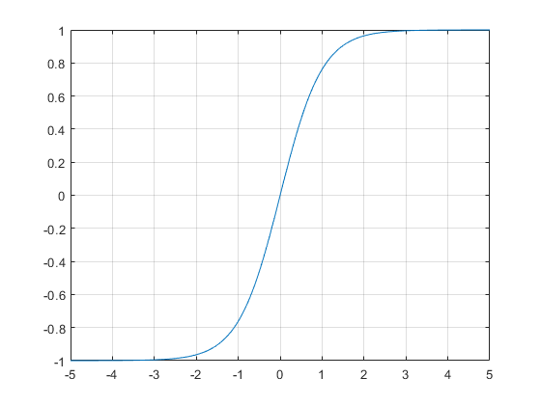

Slide 14
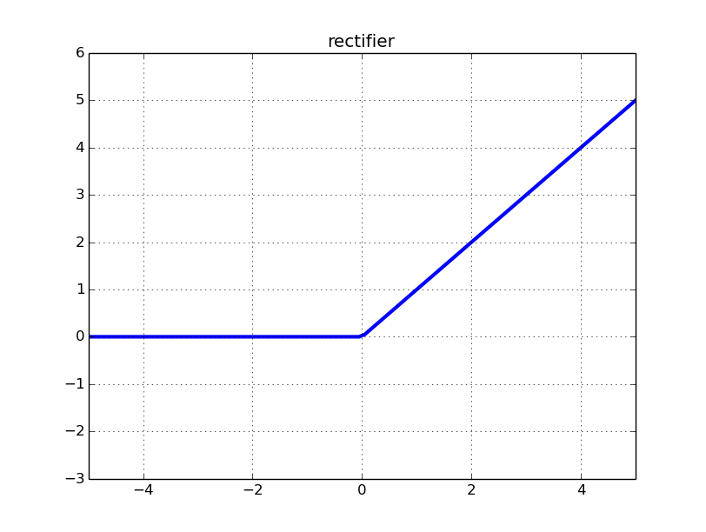

Slide 16
